Slide 1
Bug Findings
&
Bug Analysis
SQA: Manual & Automated Testing

Slide 2
Bug
Error / Mistakes - An Error occurs when the Development team or the developer fails to understand a requirement definition and this misunderstanding results in code that is flawed.
Defects / Bug - A defect occurs when a situation arises like, the application is not working as per the requirement and the actual and expected result of the application or software do not match with each other.
Failure - A fault occurs in software because sometimes, due to certain factors such as lack of resources or not following proper steps which means that the logic was not incorporated to handle the errors in the application.
Error/Mistakes
Defects/Bug
Failure

Slide 3
Defect Report
Example
ID: DEF-001
Summary: Authentication - Unable to login with valid credentials.
Environment: Production/QA/Stage
Steps to Reproduce:
Go to the login page.
Enter valid credentials.
Click login.
Actual Result: Something Went Wrong, error message displayed.
Expected Result: User should be logged in.
Priority: High
Severity: Medium
Status: New/Open/TO Do
Defect ID/Ticket No/Issue No
Summary
Steps to reproduce
Actual vs Expected results
Severity and priority
Status
Environment

Slide 4
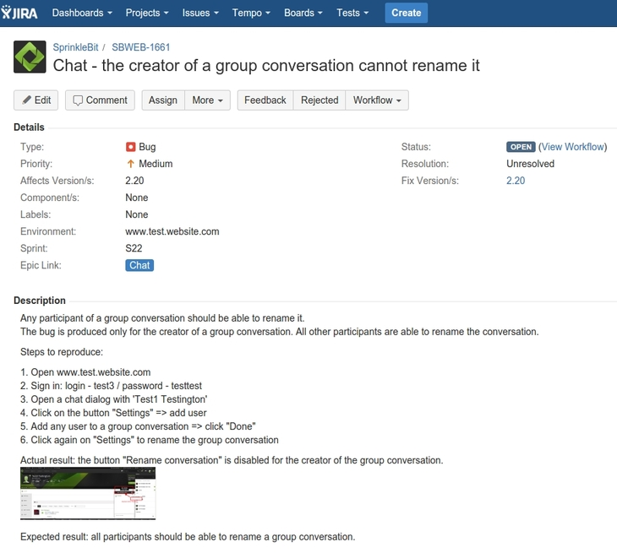

Slide 5

Defect Life Cycle
New
Open
Assign
Test
Verified
Reopened
Rejected
Deferred
Closed

Slide 6
Bug Analysis
Investigation (URL)
Solution (Optional)
Few more Websites to test:
  Buggy Website – http://the-internet.herokuapp.com/
  DemoQA – https://demoqa.com/
  ⁠OrangeHRM Demo – https://opensource-demo.orangehrmlive.com/
  SauceDemo – https://www.saucedemo.com/
  Contact List App - https://thinking-tester-contact-list.herokuapp.com/ (Investigation one)

Slide 7
How To Prevent Bugs In Brief
Review Specifications
Define Test Case Structure
Consider Happy Path, Negative Scenarios and Edge Cases
Peer Review
Test Case Execution/Testing
Log Defects/Error/Bug
Retest
Track and Update Test Cases

Slide 8
Key Points on Professionalism to prevent bugs
Clarity and Detailing in The Test Cases
Consistency in Documents structure
Thoroughness in Functional and Non-functional aspects
Traceability in User Story and Documents
Collaboration with Stakeholders
Continuous Improvement Based on Feedback and Previous result
Taking ownership of the product

Slide 9

Any Questions?
Thank you!

